Slide 1

Twitter hate detection
Sathana Ramesh

Slide 2

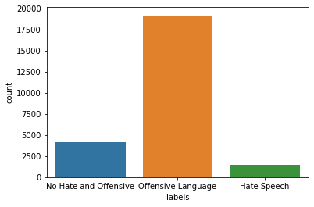
Objective
Natural Language Processing Problem where Sentiment Analysis is done by Classifying the tweets by machine learning models for classification, text mining, text analysis, data analysis and data visualization as OFFENSIVE or NO HATE AND OFFENSIVE or HATE SPEECH .

Slide 3
Flow chart
Data set from the website
Download the data and push it into GitHub.
Pre-processing
NLP is used to pre-process the data and word cloud is used .
Model creation and evaluation
Classification models are created.
Tweets are classified as offensive or no hate and offensive or hate speech on the basis of count.
Evaluation of different models are done on the basis of score.
Columns class is used in labelling the tweets

Slide 4
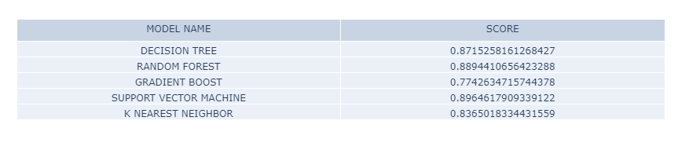
Table
Based on the scores after the testing the svm is selected as the best fit

Slide 5
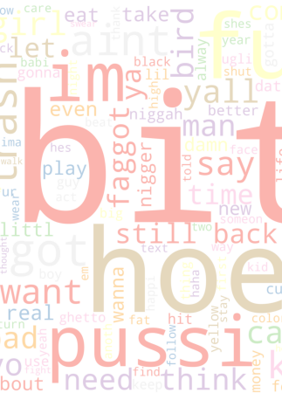
conclusion
NLP and classifiers are used to build the model.
The model is used to classify the tweets as offensive or not offensive or hate speech
This mechanism can be used to block the hate and offensive tweets from the users

Slide 6
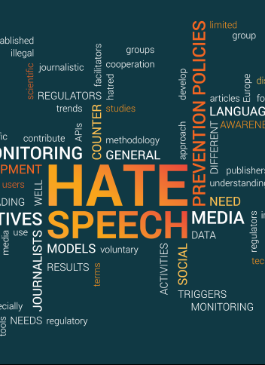
Thank you
https://github.com/SathanaR/capstone-project

